Slide 1
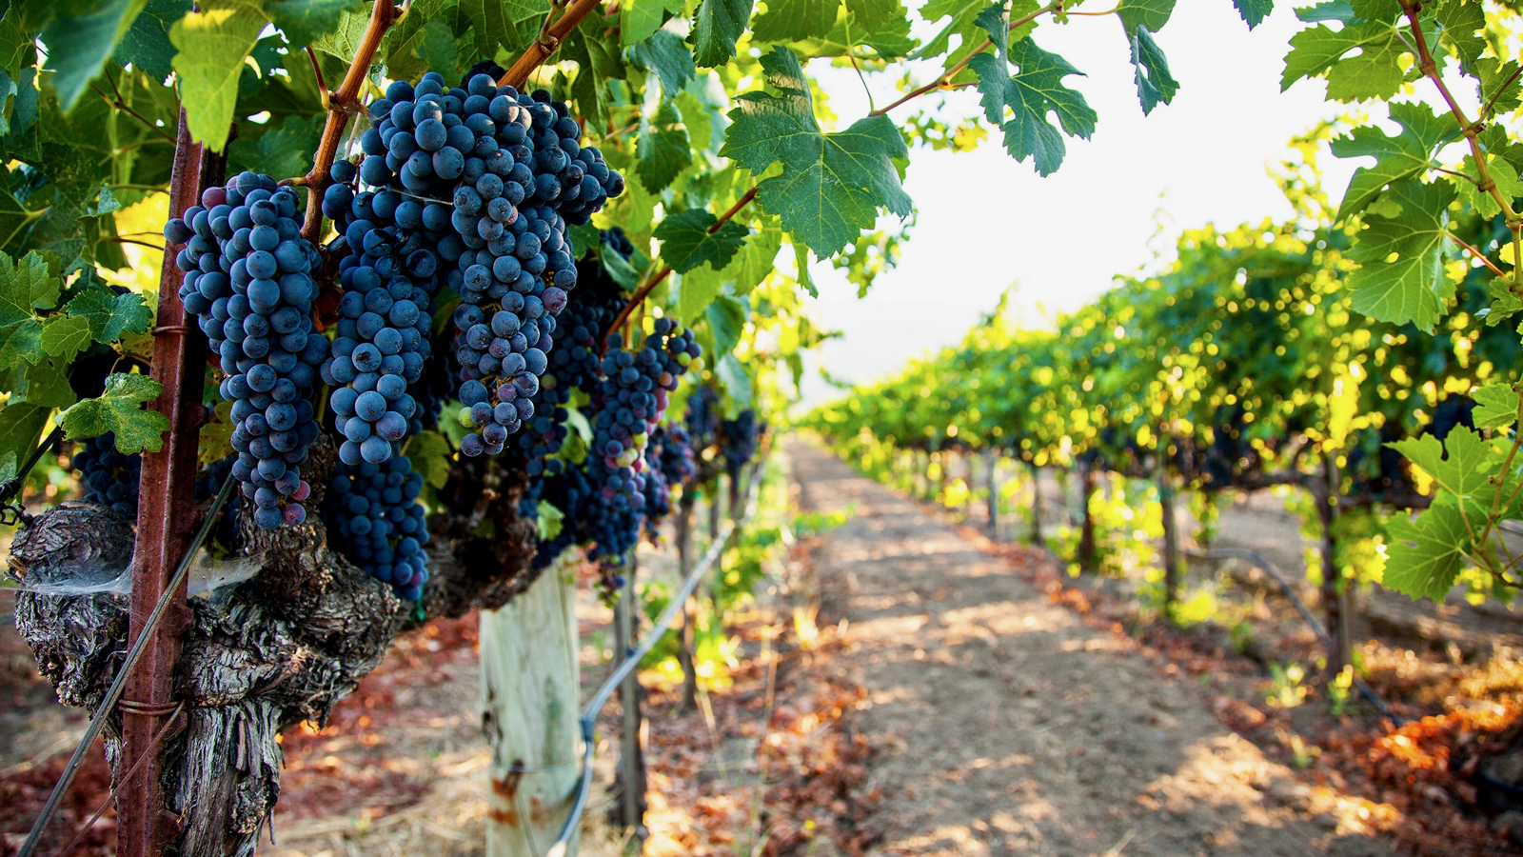
Wine Recommender System Using Tasting Notes
Morgan Murphy | DSI-2 | Capstone Project

Slide 2
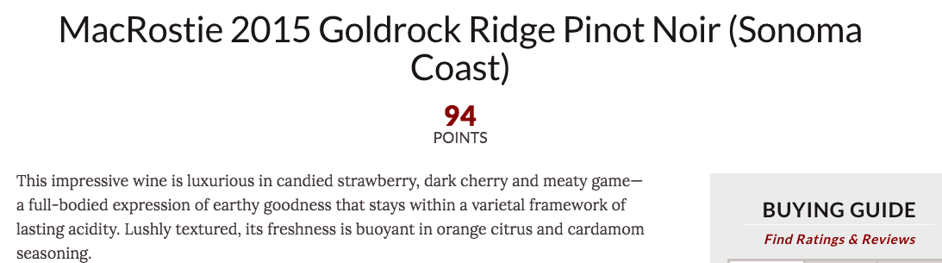
Project Purpose / Problem Statement
Can the written wine review descriptions be used to create a wine recommendation system?
Example:

Slide 3
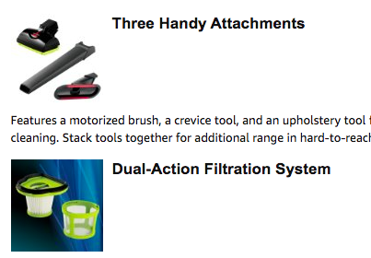
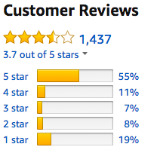
Types of Recommenders
Content-Based Recommenders: Use the content of the items alone to judge similarity between items
Collaborative-Filtering Recommenders: Use ratings from people to judge the similarity between items

Slide 4
My Process for this Project
Data Source: Kaggle dataset of 120,000+ wine reviews
Exploratory Data Analysis
Natural Language Processing (NLP):
Stemming and Tokenizing
Count Vectorization
Term Frequency-Inverse Document Frequency
K-Means Cluster Analysis
Recommendation Model: Cosine similarity scores using SKLearn‘s Linear-Kernel

Slide 5
Exploratory Data Analysis

Slide 6
Data Cleaning/EDA
Data Cleaning:
Dropped duplicate entries
Dropped rows where there were only a few null values
Dropped columns that would not be used and had lots of nulls
Decided to keep only the top 20 varietals
Data visualization of remaining variables

Slide 7
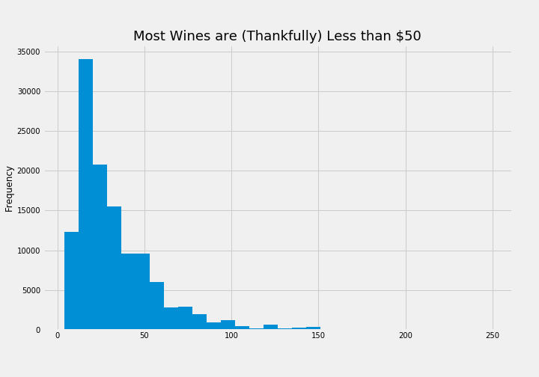
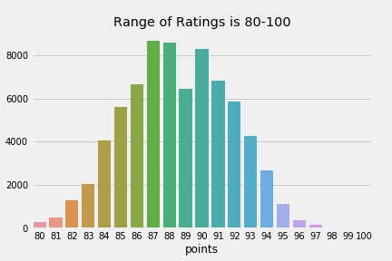
Distributions of Price and Ratings

Slide 8
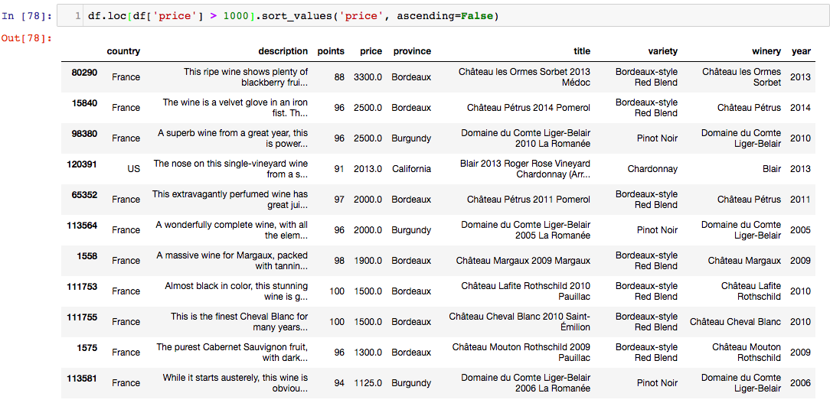
Wines over $1000

Slide 9
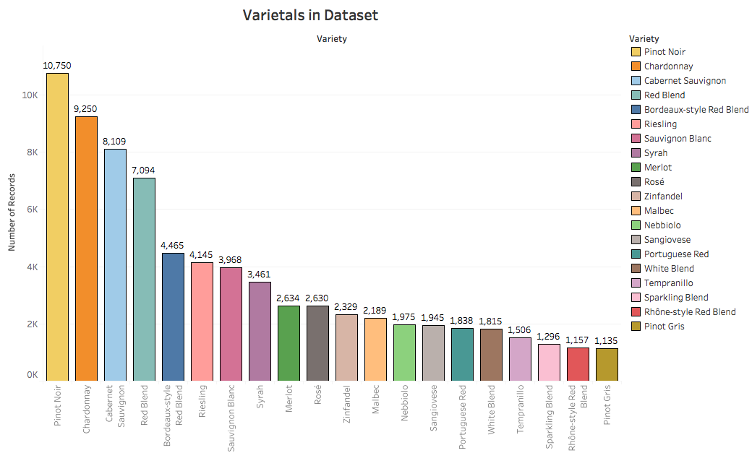

Slide 10
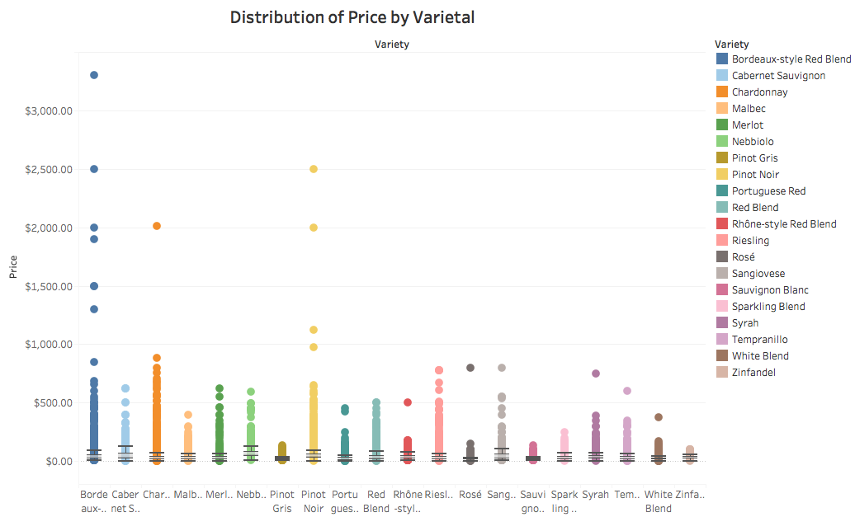

Slide 11
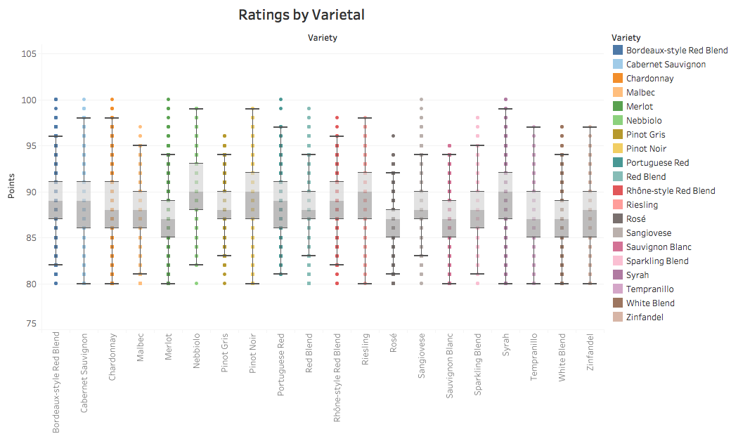

Slide 12
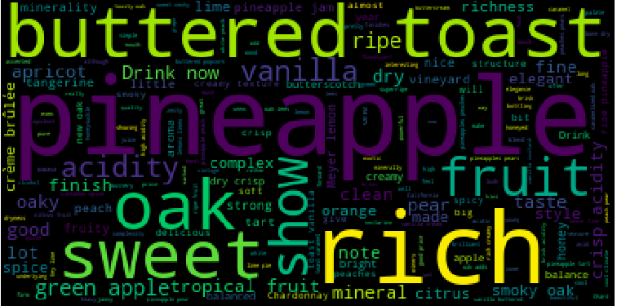
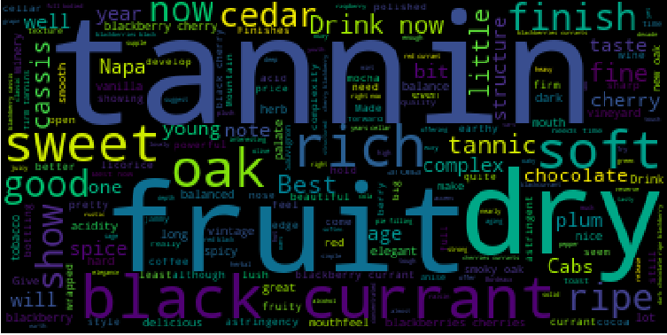
Word Clouds as Intro to NLP
California Chardonnay
California Cabernet

Slide 13
Count Vectorizer: Most Common Words
Fruit
Finish
Cherries
Aroma
Acid
Palate
Tannin
Black
Ripe
Dry
Note
Spice
Rich
Oak
Berries
Fresh
Question: Do you think some of these should be
Stop Words?

Slide 14
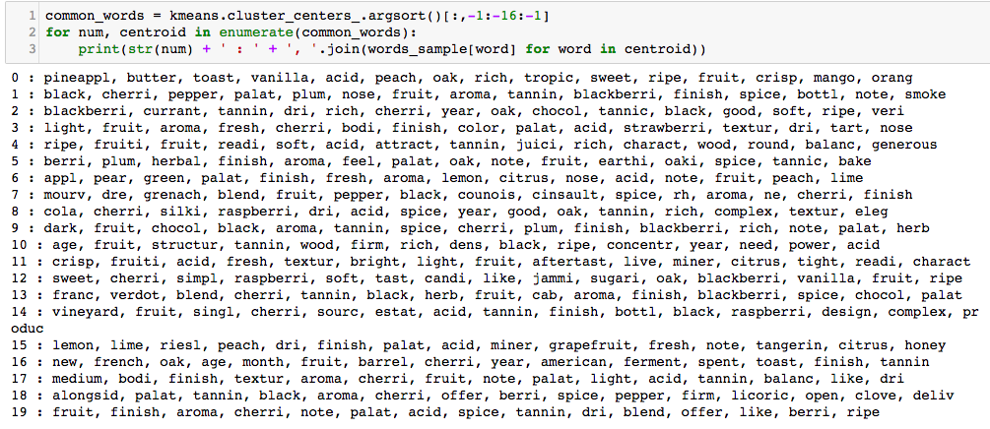
K-Means Cluster Analysis: 20 Clusters

Slide 15
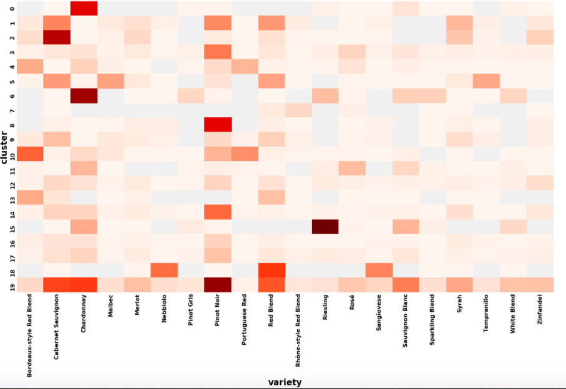

Slide 16
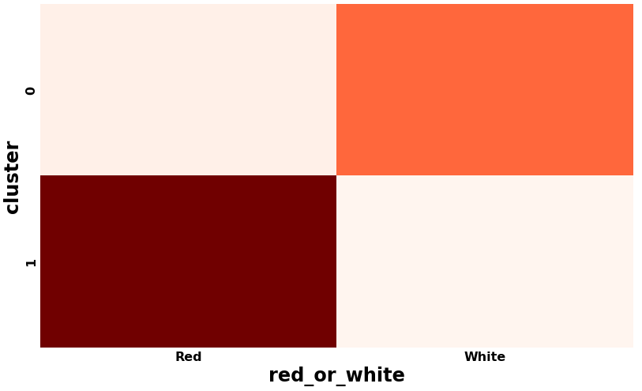
K-Means: Red vs. White Wine

Slide 17
Recommender System

Slide 18
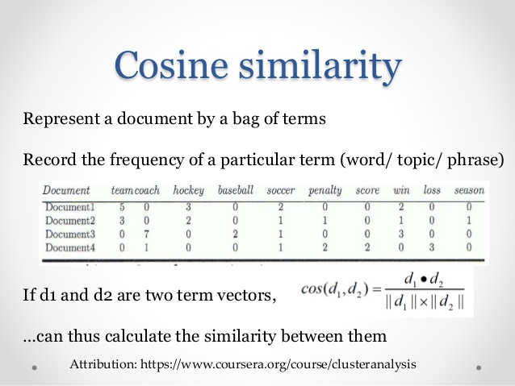

Recommender Model: Cosine Similarity
After tokenizing, each wine is a “document”
SKLearn Linear-Kernel calculates the cosine similarity score between each document
In our database, that creates $\sim$ 70,000 x 70,000 matrix of similarity scores

Slide 19
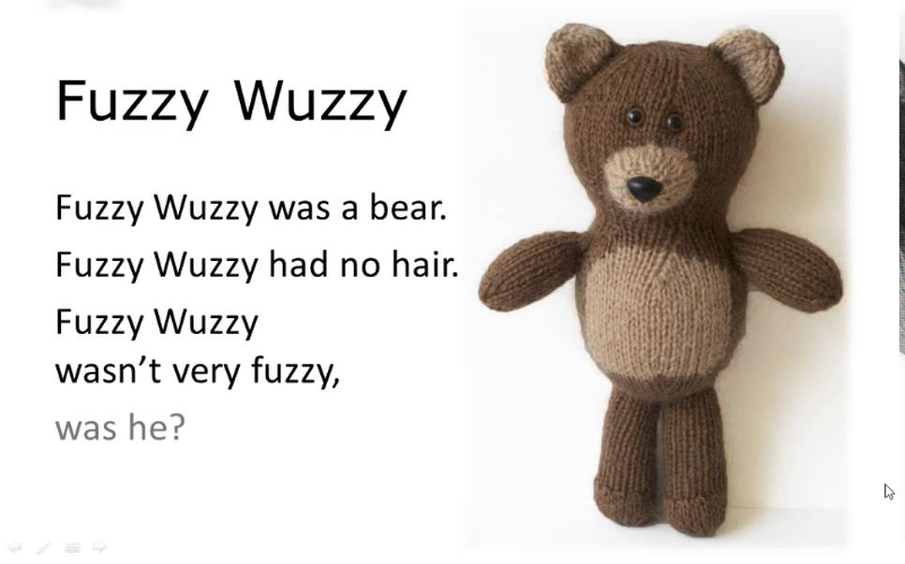
Fuzzy Wuzzy Searching
Identifies strings that do not match exactly:
“Data Scientist”
“data scientist”
“Data Science”
Recommender uses two fuzzy wuzzy searches:
One: To help the user identify the wine they want to use
Two: To identify the exact title from the dataframe

Slide 20

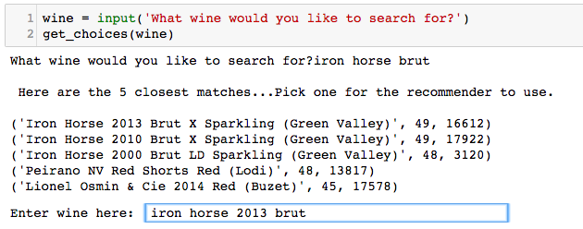
Searching…

Slide 21
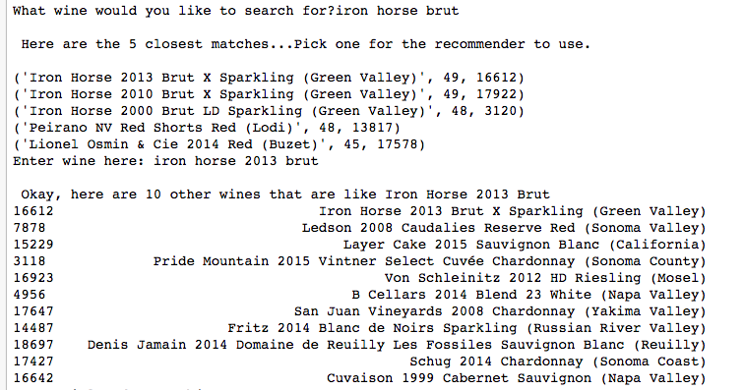
Survey Says…

Slide 22
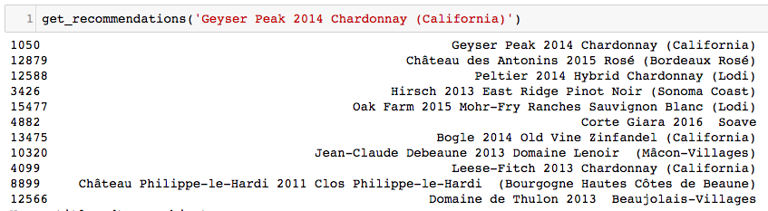
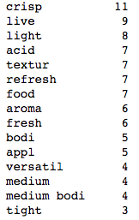
Recommendation: A Chardonnay
Most Common Words in the Descriptions of the Recommended Wines

Slide 23
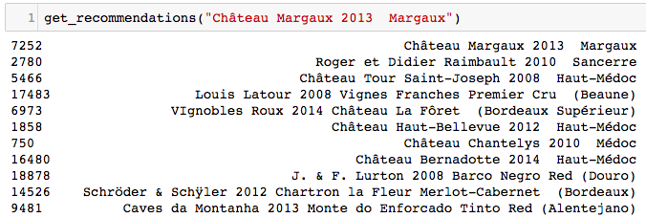
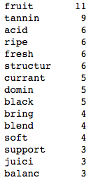
Recommendation: High-End Red
Most Common Words in the Descriptions of the Recommended Wines

Slide 24
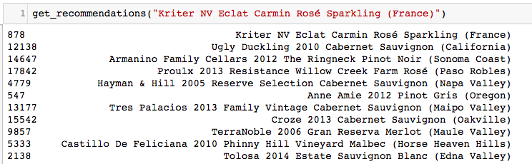
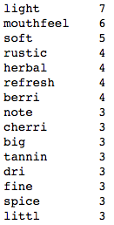
Recommendation: French Sparkling
Most Common Words in the Descriptions of the Recommended Wines

Slide 25
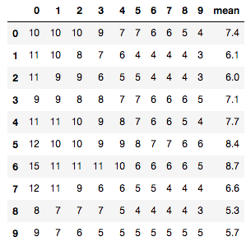
Evaluation Metric
For each recommendation, I calculated the average number of times the top 10 words appear
Across a sample of 100 recommendations = 6.6
Reds Only: 6.7
Whites Only: 6.7

Slide 26
Outcome: Problem Statement
Can the written wine review descriptions be used to create a wine recommendation system?
Example:

Slide 27
Outcome: Problem Statement
Can the written wine review descriptions be used to create a wine recommendation system?
Answer: YES!
However, similar to how liking or disliking of wine is such a matter of personal preference, a user’s assessment of whether the recommendation is “correct” will probably be just as personal

Slide 28
Next Steps
Further refine the recommender
Specific to red or white, but using one dataframe
Specific to price, or varietal, or country
Wines that are still available for purchase
Use DJango to create online user interface
Name and copyright my evaluation metric (kidding)

Slide 29
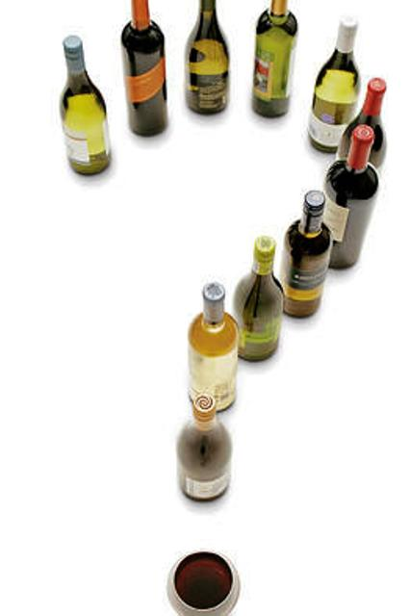
Questions

